Slide 1

Welcome to
Rotary Club Central Goals
PDG Pete Booker
Robin Broomall
Executive Secretary Newark Morning Club

Slide 2

District 7630 Pre-PETS 2023
ROTARY CLUB CENTRAL:
Why it’s important and how to use it
Robin Broomall rbroomall@usa.net
Pete Booker peteb81151@gmail.com

Slide 3
Here’s how to access Rotary Club Central:
Log into Rotary.org
Log into MyRotary – Don’t have a MyRotary account: Here’s how you set one up:
Go to "For Members" and click on MyRotary or click on MyRotary where ever you see it.
Click on Sign In/Register.
If you are a first time user, click on Create account.
Fill in the Account registration information and click on Continue.

Slide 4
Have your member number and club number ready. They can be found on DACdb.
You will be informed that an e-mail has been sent to you.
You will receive a message which will ask you to click on the blue link to finalize the process.
Fill in all the mandatory information and click on Create account.
When the screen refreshes you will be given information describing what you can do with the MyRotary account. After reading, click on Continue.

Slide 5
Here’s how to access Rotary Club Goals:
When logged into MyRotary, click on MANAGE
In Manage, click on CLUB ADMINSTRATION
In Club Administration, click on ROTARY CLUB CENTRAL
When in Rotary Club Central, click on GOAL CENTER
Select your Rotary year (2023-2024)

Slide 7
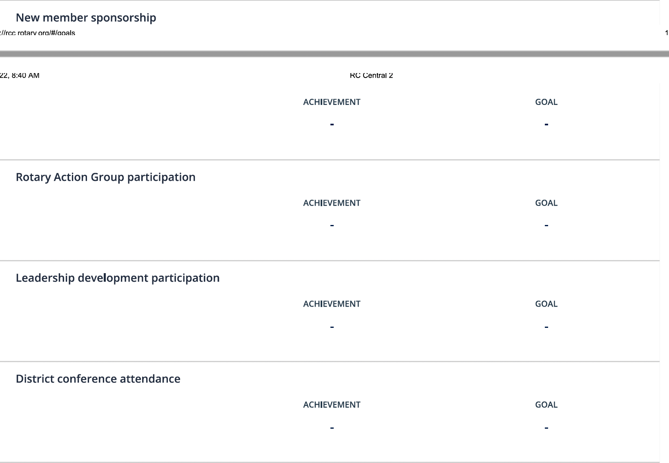

Slide 8
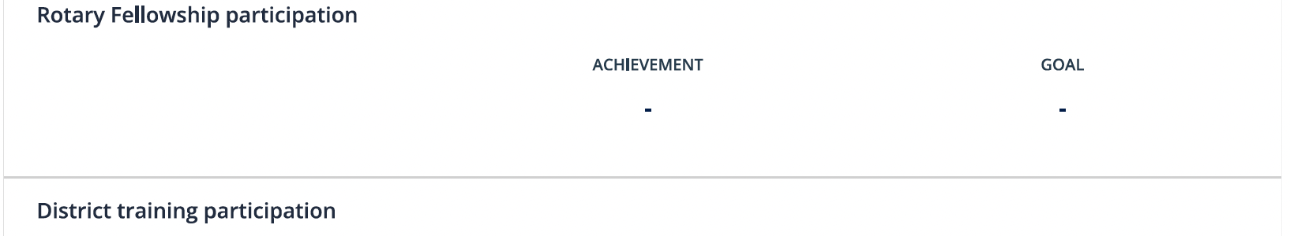
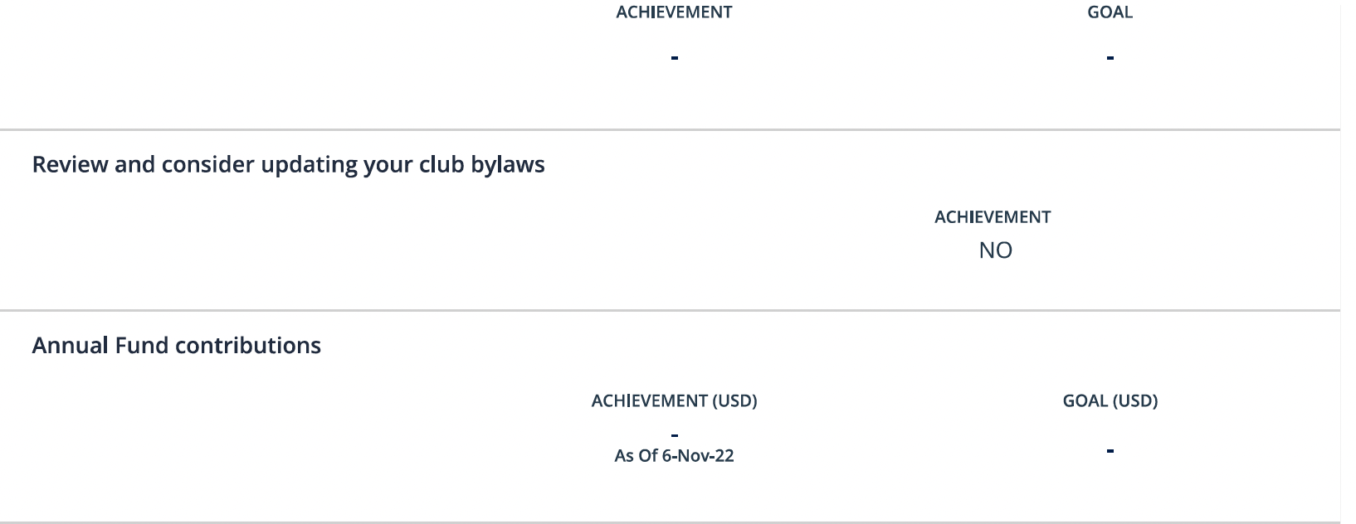

Slide 9
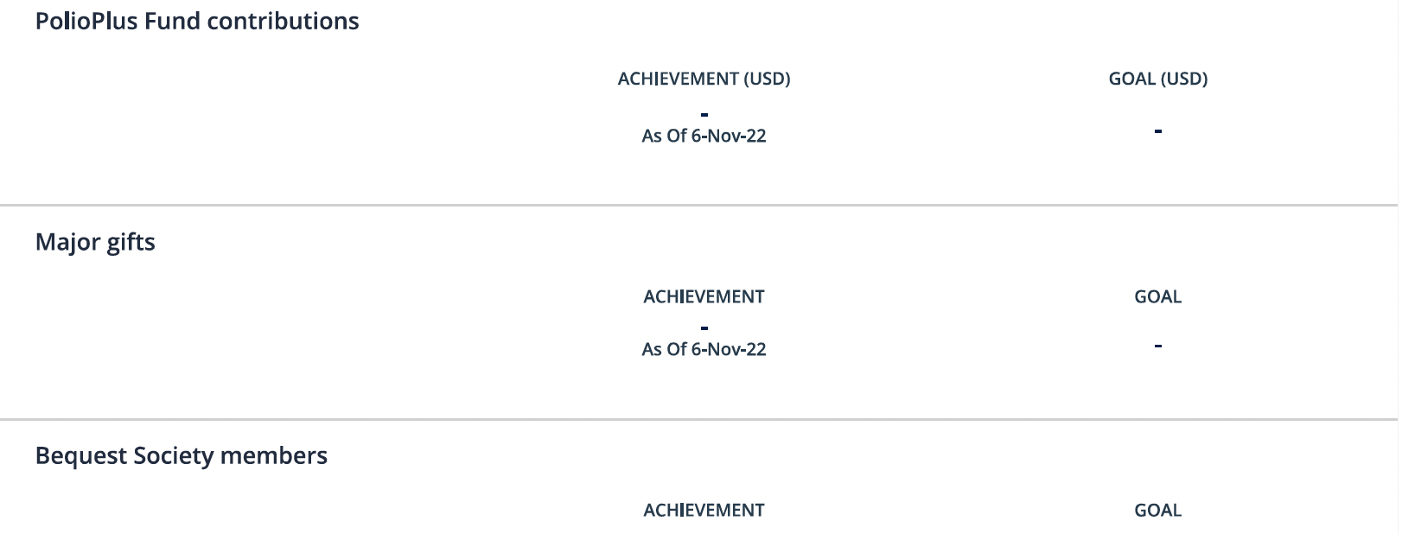
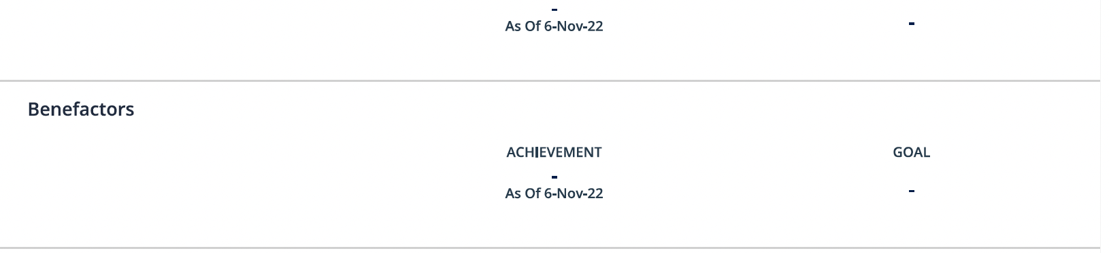

Slide 10
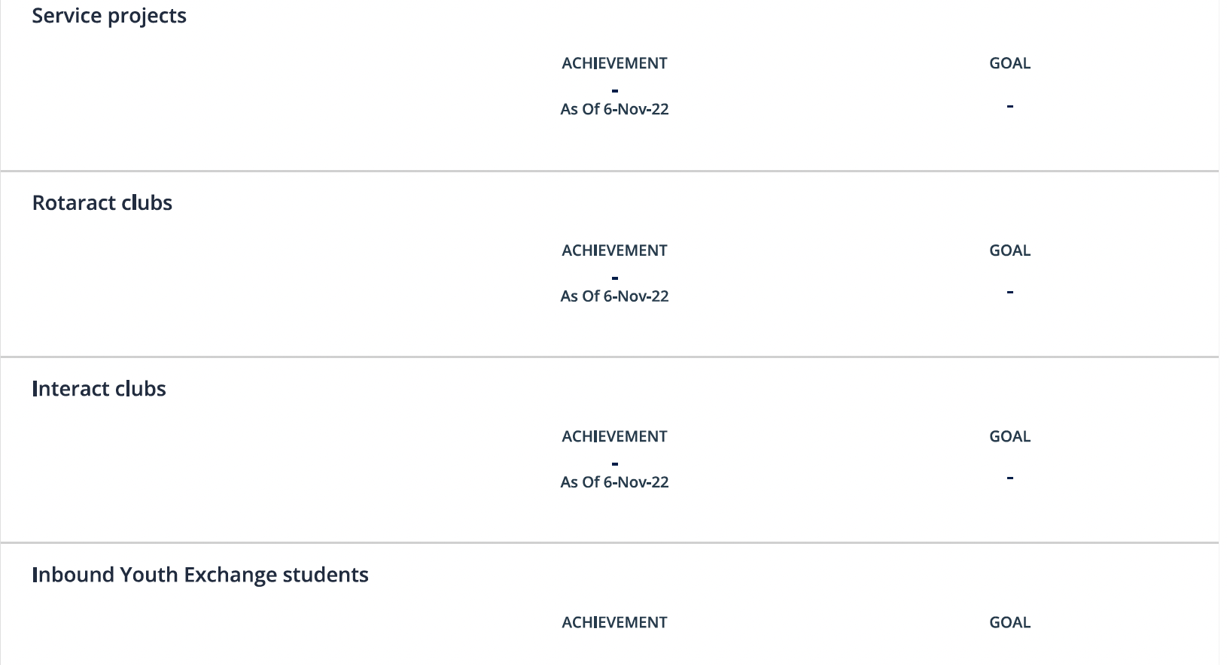

Slide 11
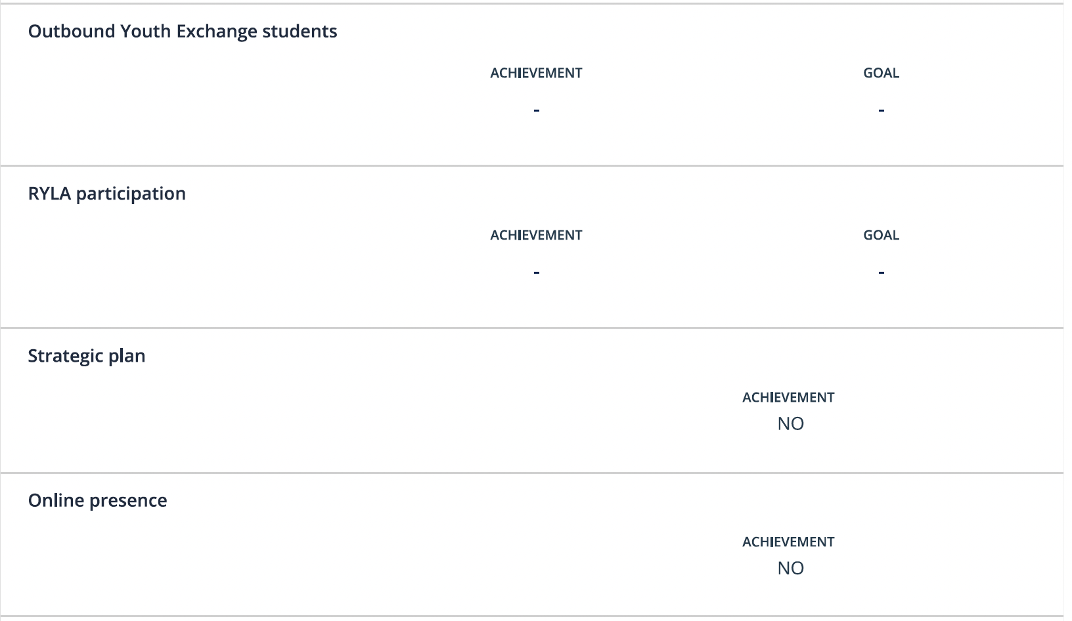

Slide 12
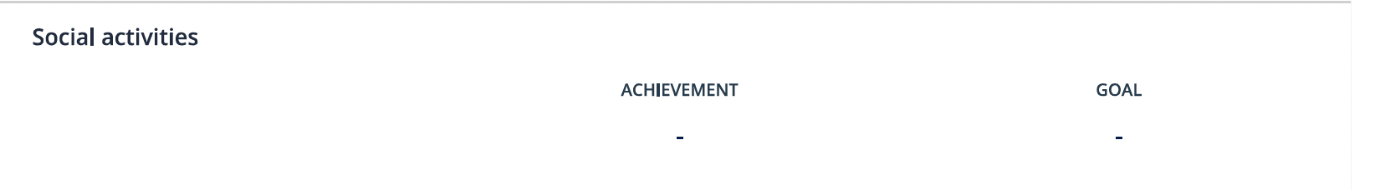
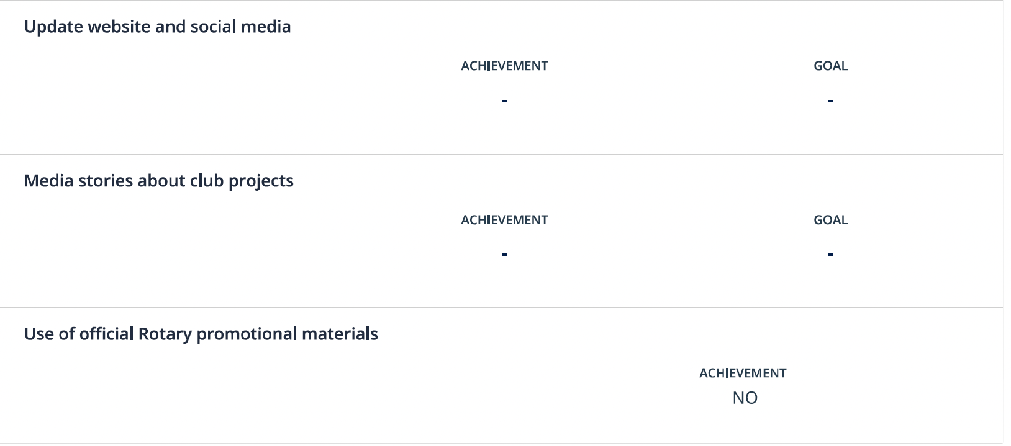

Slide 13
District 7630 Pre-PETS 2023
ROTARY CLUB CENTRAL:
Why it’s important and how to use it
Robin Broomall rbroomall@usa.net
Pete Booker peteb81151@gmail.com

